Slide 1
VE370 Midterm RC
2019.10.23
TA Group

Slide 2
General Tips
Slides are very important
Difficulty: homework > exam > slides (from my experience)

Slide 3
Problem Guessing
CPU performance
Multiple choice, conceptual
Time calculation and comparison
Assembly
Instructions characteristics, MIPS characteristics
Function calling
Single cycle CPU
Data flow
Pipeline CPU
Control signals flow
Data hazards
Where, when, how
solutions

Slide 4
Selected Details from Slides

Slide 5




Slide 6
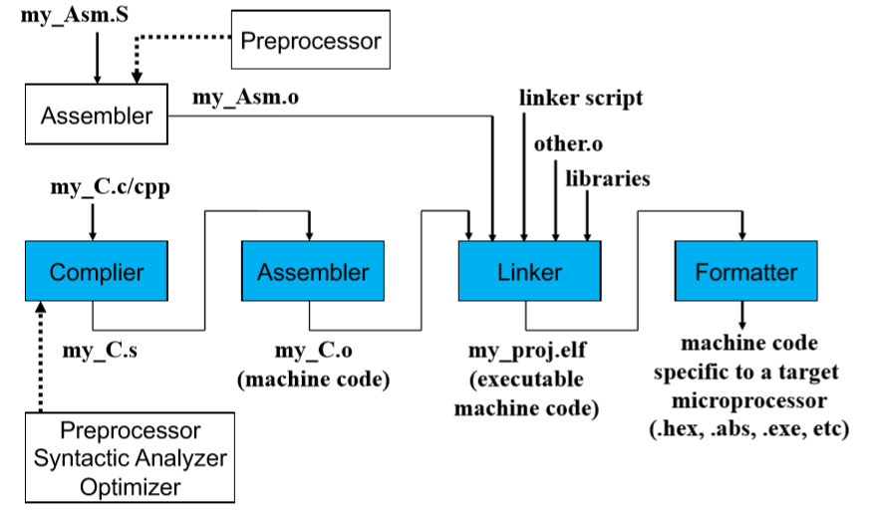

Slide 7
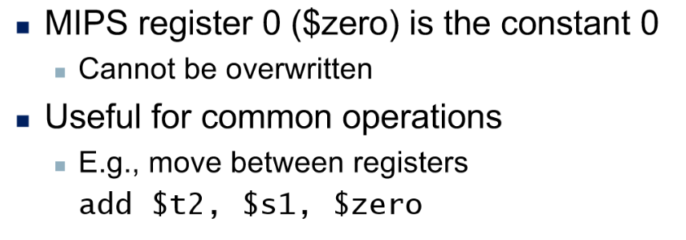

Learn how to use MIPS RefCard!!!

Slide 8
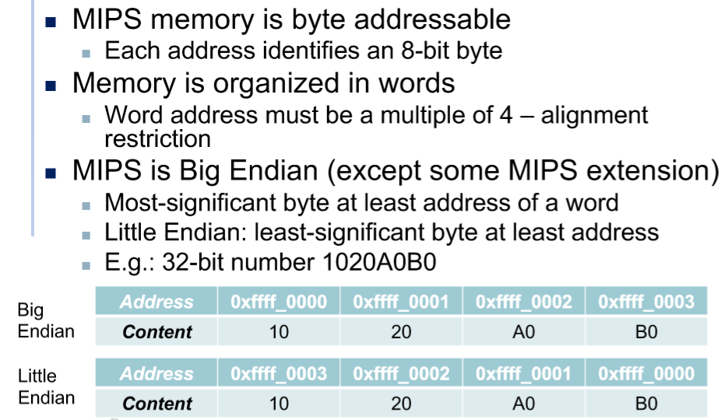

Slide 9
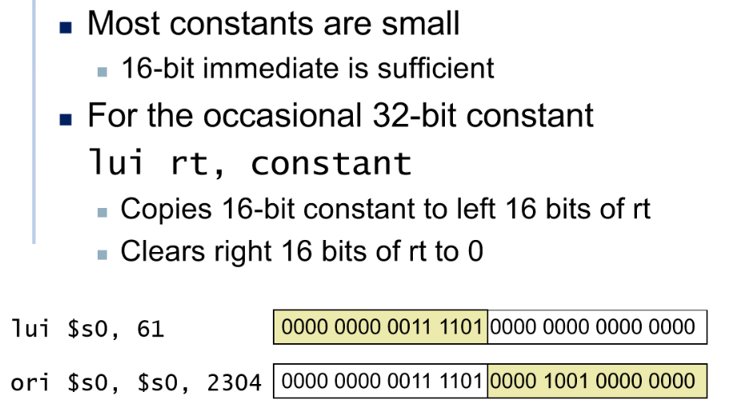

Slide 10
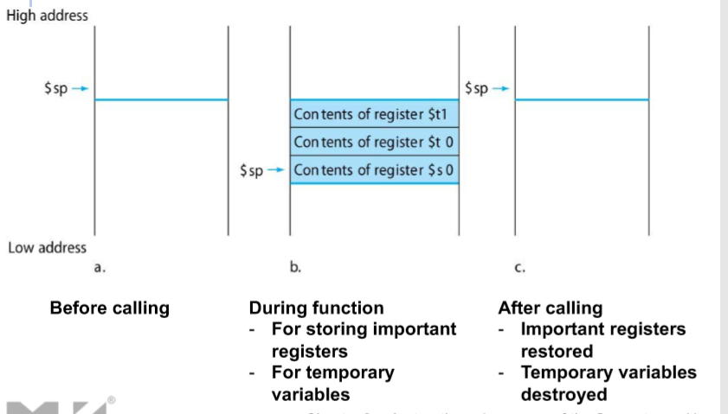
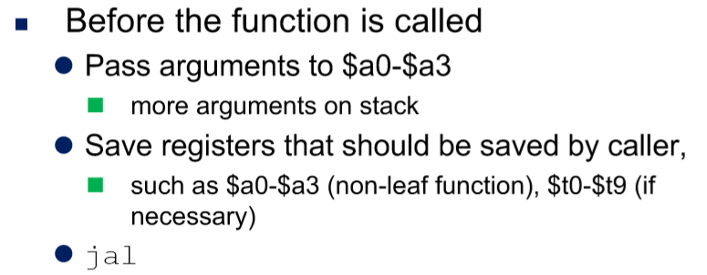
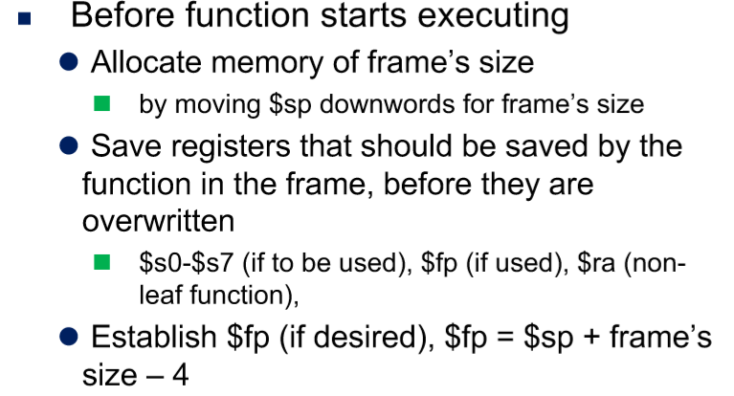
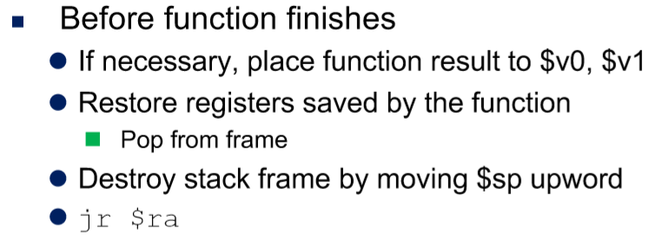

Slide 11



Slide 12
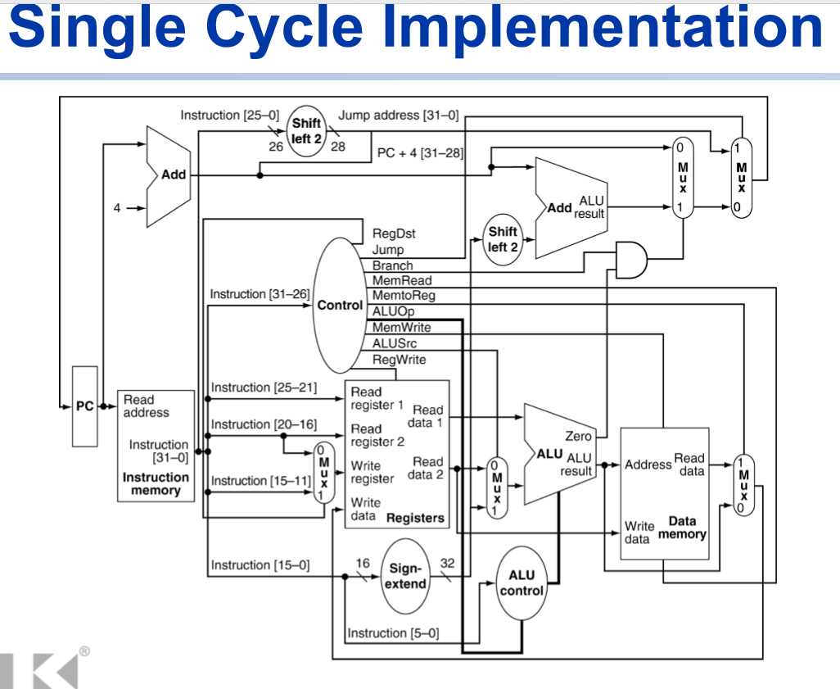

Slide 13
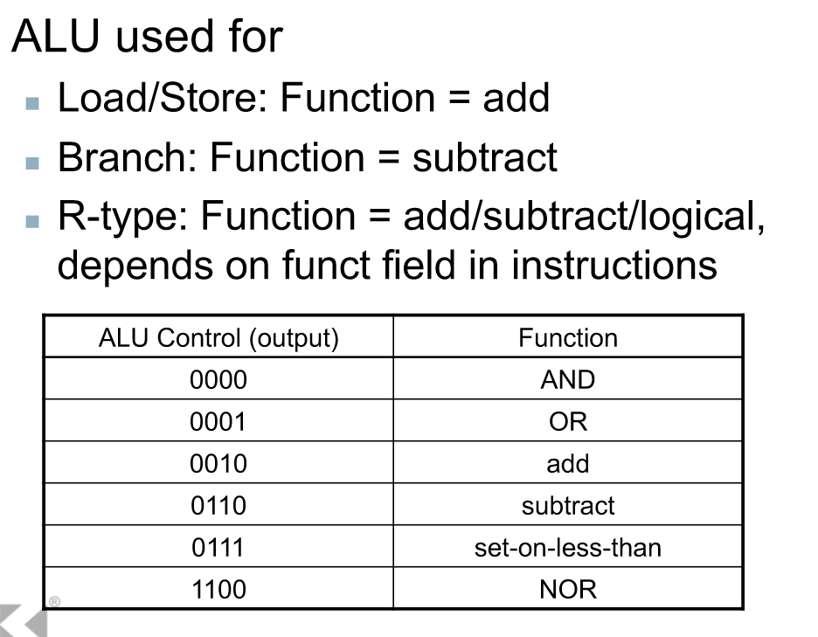

Slide 14


Slide 15
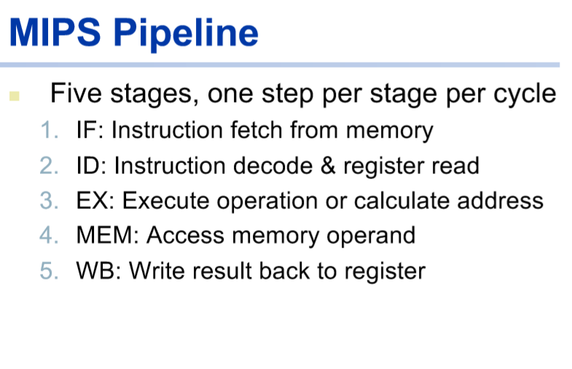

Slide 16
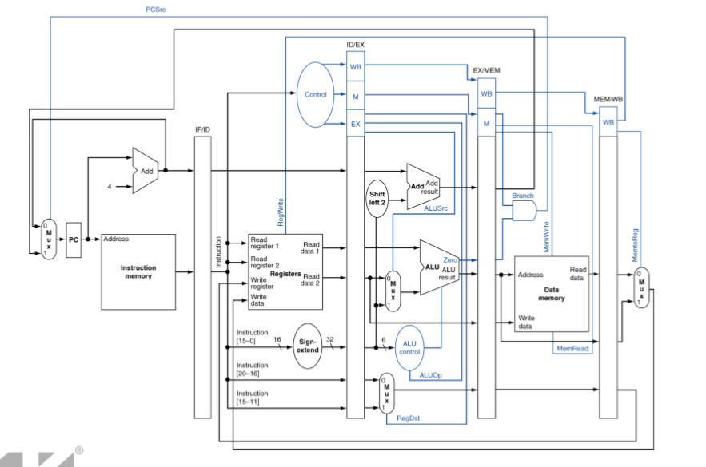

Slide 17
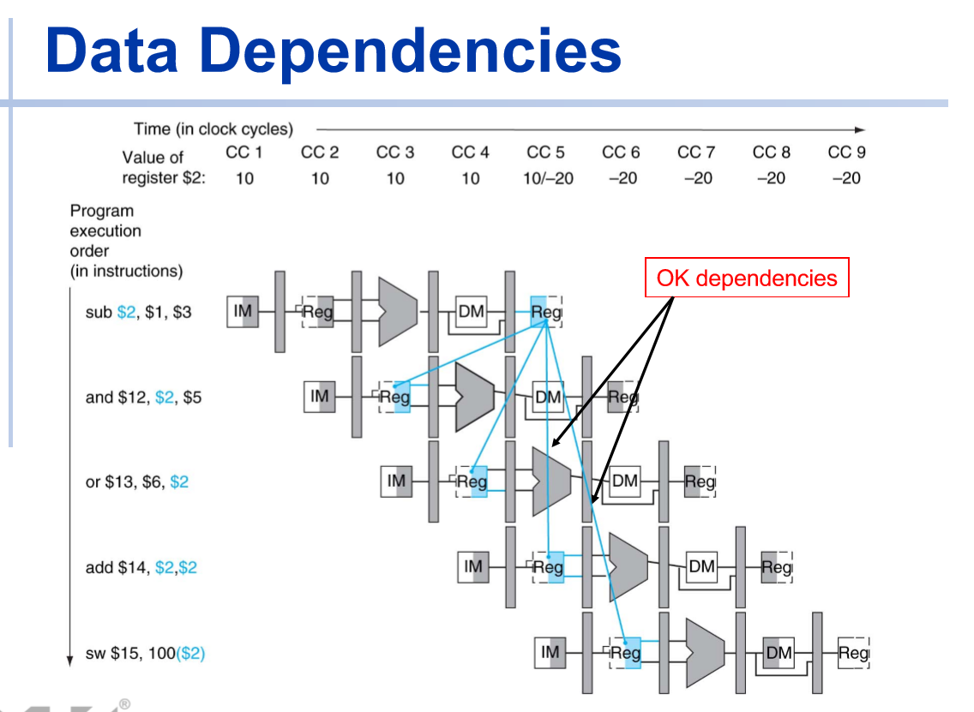

Slide 18
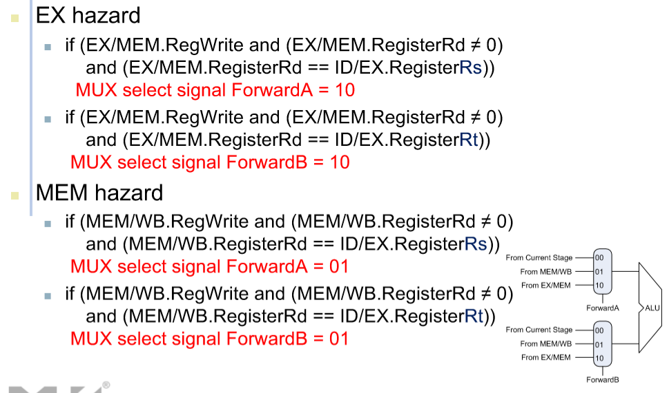

Slide 19
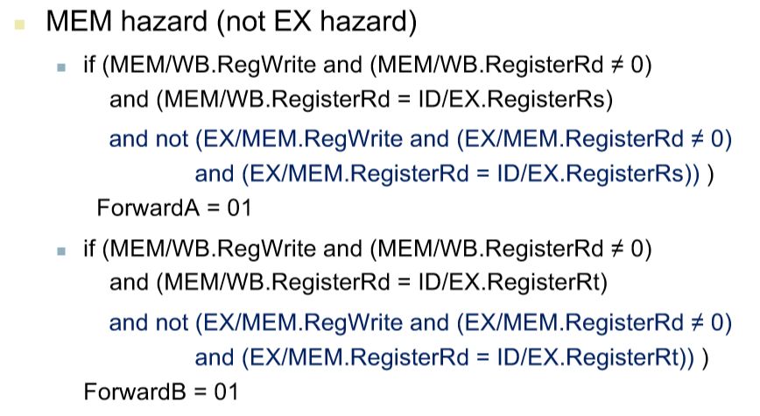

Slide 20
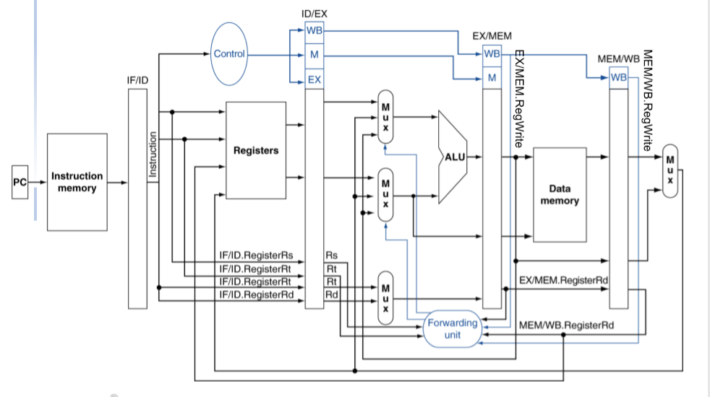

Slide 21

